Slide 1
Clustering
𝖣 Clustering or cluster analysis is the task of grouping a set of objects in such a way that
𝖣 Objects in the same group (called a cluster) are more similar (in some sense) to each other than to those in other groups (clusters).
𝖣 Useful for:
Automatically organizing data
Understanding hidden structure in data
Pre processing for further analysis

Slide 2
Applications include
Grouping of news online
Biology: Classification of plant and animal kingdom given their features
Marketing: Customer segmentation based on customer data and past records
Recognize communities in social network
Biology: taxonomy of living things: kingdom, phylum, class, order, family, genus and species
Information retrieval: document clustering
Land use: Identification of areas of similar land use in an earth observation database
City-planning: Identifying groups of houses according to their house type, value, and geographical location
Earth-quake studies: Observed earth quake epicenters should be clustered along continent faults
Climate: understanding earth climate, find patterns of atmospheric and ocean
Economic Science: market research

Slide 3
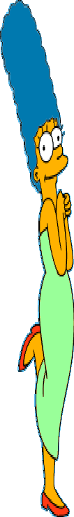

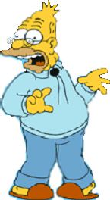


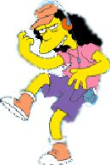


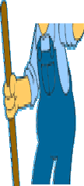

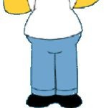



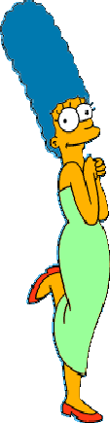

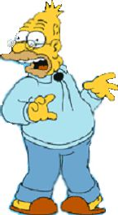
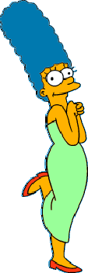





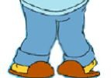

















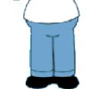


What is a natural grouping among these objects?
Clustering is subjective
Simpson's Family School Employees
Females
Males

Slide 4

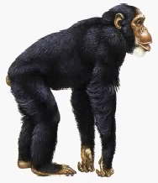
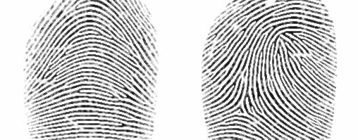














Defining Distance Measures
Definition: Let O₁ and O₂ be two objects from the universe of possible objects. The distance (dissimilarity) between O₁ and O₂ is a real number denoted by D(O₁,O₂)
Peter
Piotr
0.23
3
342.7

Slide 5
Aspects of clustering
A clustering algorithm
Partitional clustering
Hierarchical clustering
A distance (similarity, or dissimilarity) function
Clustering quality
Inter-clusters distance ⇒ maximized
Intra-clusters distance ⇒ minimized
The quality of a clustering result depends on the algorithm, the distance function, and the application

Slide 6
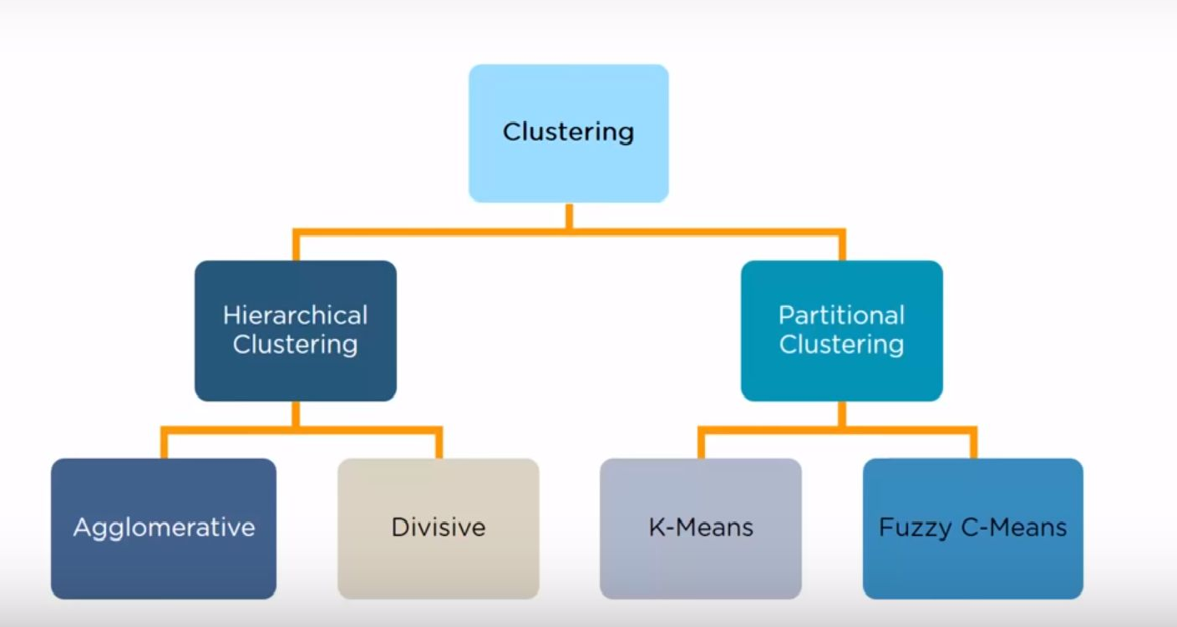
Types of Clustering

Slide 7
Major Clustering Approaches
11
Partitioning approach:
Construct various partitions and then evaluate them by some criterion, e.g., minimizing the sum of square errors
Typical methods: k-means, k-medoids
Hierarchical approach:
Create a hierarchical decomposition of the set of data (or objects) using some criterion
Typical methods: Diana(Divisive Analysis), Agnes(Agglomerative Nesting), BIRCH, CAMELEON
Density-based approach:
Based on connectivity and density functions
Typical methods: DBSACN, OPTICS, DenClue

Slide 8
Partitional
𝖣 Simply a division of the set of data objects into non-overlapping subsets (clusters) such that each data object is in exactly one subset.
𝖣 Eg K Means

Slide 9
k-means clustering
𝖣 One of the simplest unsupervised learning algorithms for solving the clustering problem.
𝖣 Start by choosing k points arbitrarily as the “centres” of the clusters, one for each cluster.
𝖣 Then associate each of the given data points with the nearest centre.
𝖣 Now take the averages of the data points associated with a centre and replace the centre with the average, and this is done for each of the centres.
𝖣 Repeat the process until the centres converge to some fixed points.

Slide 10
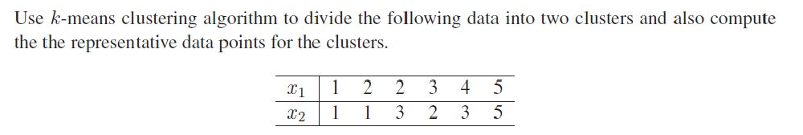

k-means clustering – Problem 1
𝖣 The distance between the points (x1, x2) and (y1, y2) will be calculated using the familiar distance formula of elementary analytical geometry:

Slide 11

Solution
In the problem, the required number of clusters is 2 and we take k = 2.
We choose two points arbitrarily as the initial cluster centres. Let us choose arbitrarily
3. We compute the distances of the given data points from the cluster centers.

Slide 12
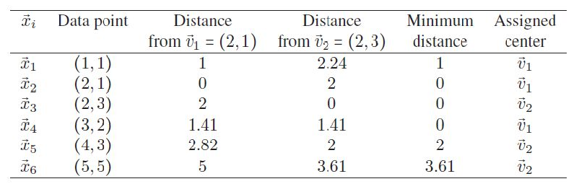
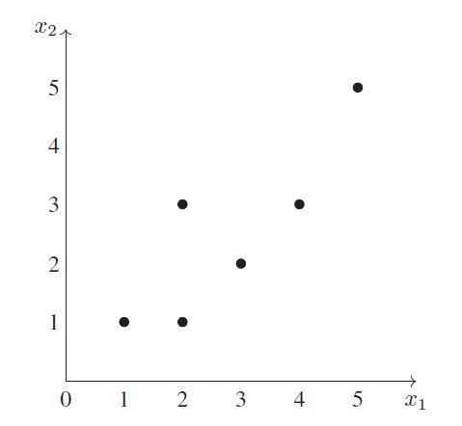
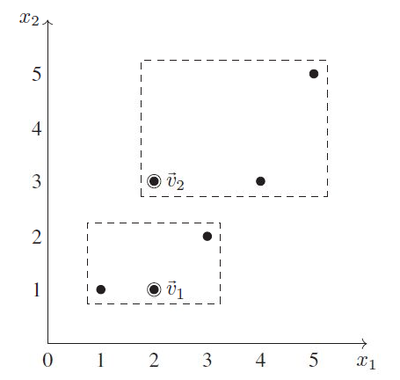

Slide 13
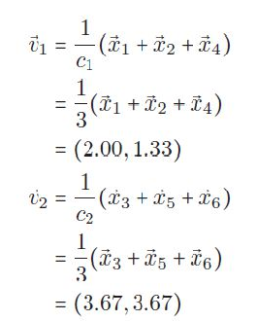
4. The cluster centres are recalculated as follows:
5. We compute the distances of the given data points from the new cluster centers.

Slide 14
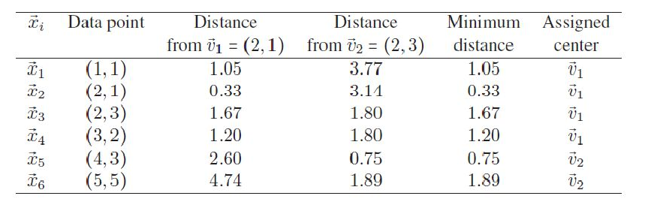
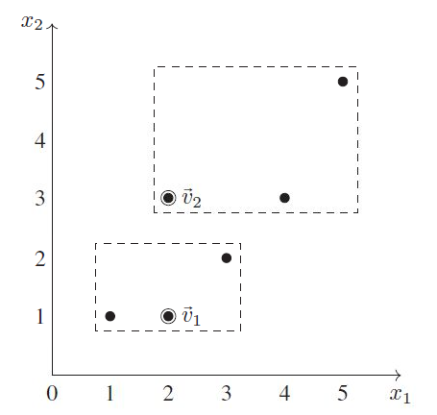
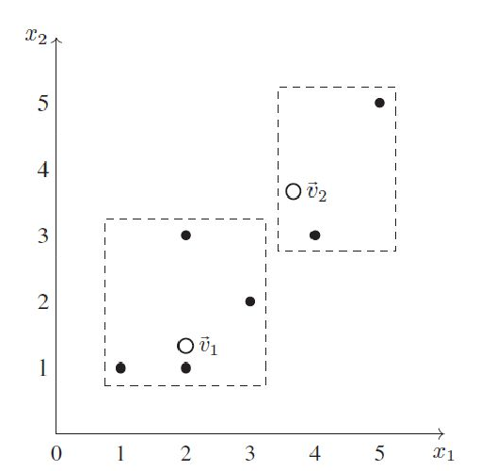

Slide 15
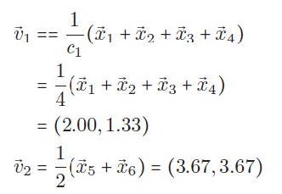
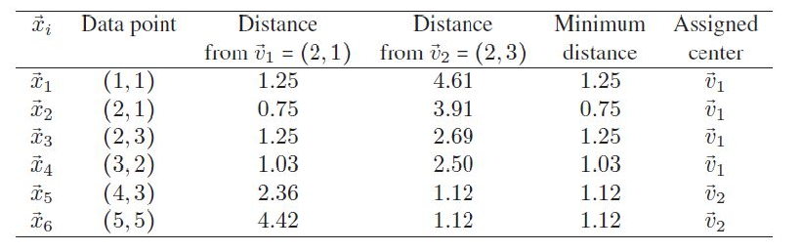
6. The cluster centres are recalculated as follows:
7. We compute the distances of the given data points from the new cluster centers.

Slide 16
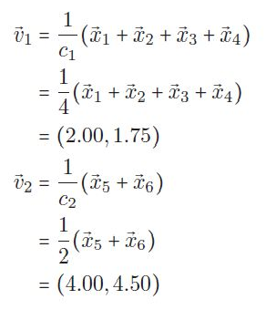
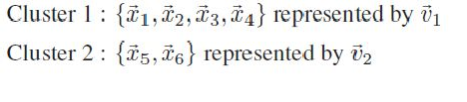
8. The cluster centres are recalculated as follows:
9. This divides the data into two clusters as follows

Slide 17
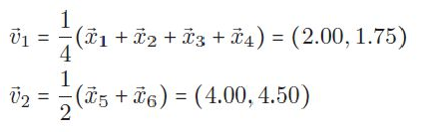

10.The cluster centres are recalculated as follows:
These are identical to the cluster centres calculated in Step 8. So there will be no reassignment of data points to different clusters and hence the computations are stopped here.
Conclusion: The k means clustering algorithm with k
= 2 applied to the dataset yields the following clusters and the associated cluster centres:

Slide 18
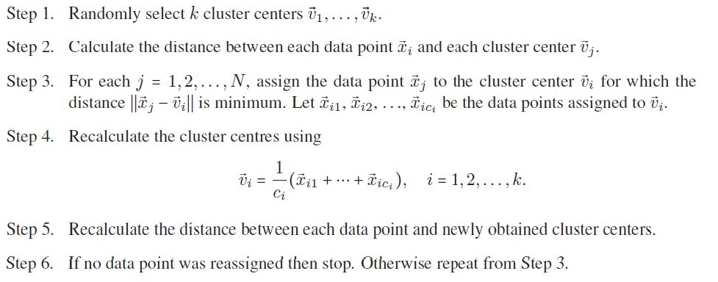
k-means clustering - Algorithm

Slide 19
Disadvantage of K means clustering
Learning algorithm requires apriori specification of number of clusters
Final cluster depends on the initial selection of centroids (seed points)
With different representation of data, we get different results (Cartesian and Polar coordinate representation)
Cannot be applied to categorical data
Random selection of initial cluster centre is not efficient
Euclidian distance can unequally weight underlying factors

Slide 20
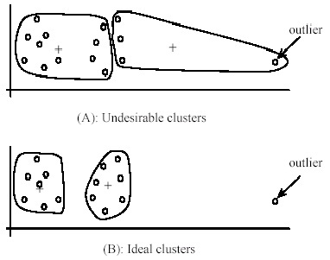
Weaknesses of k-means: Problems with
outliers

Slide 21
Hierarchical clustering
𝖣 is a method of cluster analysis which seeks to build a hierarchy of clusters (or groups) in a given dataset.
𝖣 The hierarchical clustering produces clusters in which the clusters at each level of the hierarchy are created by merging clusters at the next lower level.
𝖣 The decision regarding whether two clusters are to be merged or not is taken based on the measure of dissimilarity between the clusters.

Slide 22
Hierarchical clustering -Dendrograms
𝖣 A dendrogram is a tree diagram used to illustrate the arrangement of the clusters produced by hierarchical clustering.

Slide 23

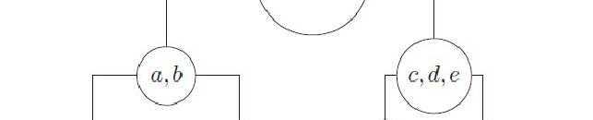
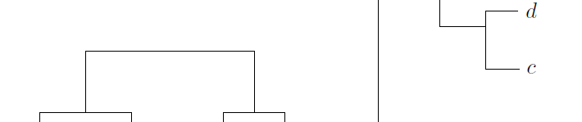
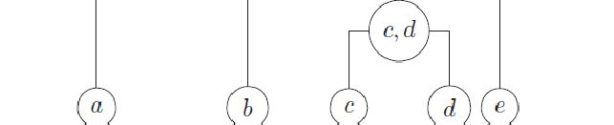
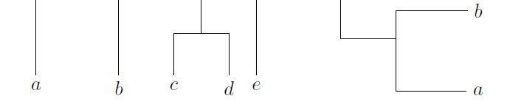
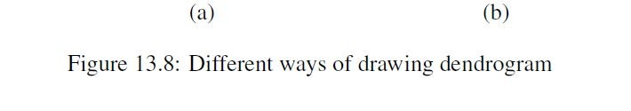
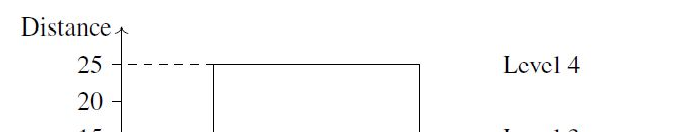
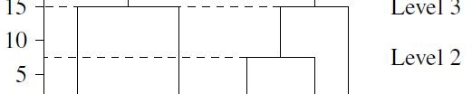
A dendrogram of the dataset {a,b, c, d, e} showing the distances (heights) of the clusters at different levels

Slide 24
Methods for hierarchical clustering
𝖣 There are two methods for the hierarchical clustering of a dataset.
𝖣 Agglomerative method (AGNES)
or the bottom-up method
𝖣 Divisive method (DIANA)
the top-down method

Slide 25
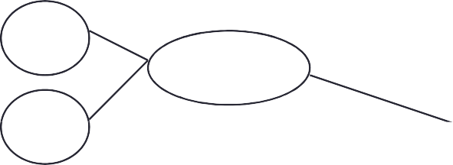
Step 1
Step 0
Step 2
Step 3
Step 4
agglomerative (AGNES)
a
a b
b
a b c d e
c
c d e
d
d e
e
divisive (DIANA)
Step 4
Step 3
Step 2
Step 1
Step 0

Slide 26
Measures of distance between groups of data points
𝖣 Let A and B be two groups of observations and let x and y be arbitrary data points in A and B respectively.
𝖣 d(x, y) denote the distance between x and y.
𝖣 d(A,B) is the distance between the groups A and B.

Slide 27

Measure of dissimilarity
𝖣 Complete linkage clustering.
d(A,B) = max{d(x, y) x > A, y > B}.
The method is also known as farthest neighbour clustering.
𝖣 Single linkage clustering
d(A,B) = min{d(x, y) x > A, y > B}.
The method is also known as nearest neighbour clustering.
𝖣 Average linkage clustering
Where |A| and |B| are respectively the number of elements in A and B.
It is also known as UPGMA (Unweighted Pair Group Method with Arithmetic Mean).

Slide 28
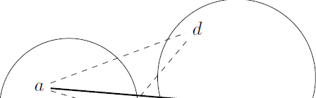
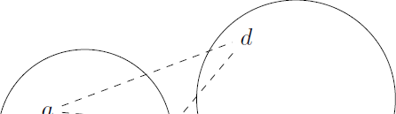
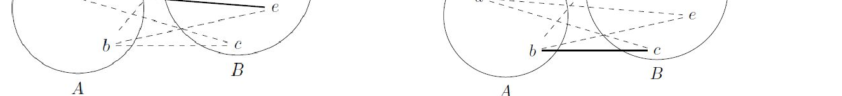
Complete linkage clustering.
Single linkage clustering

Slide 29
Divisive method
𝖣 The divisive method starts at the top and at each level recursively split one of the existing clusters at that level into two new clusters.
𝖣 If there are N observations in the dataset, then the divisive method will produce N − 1 levels in the hierarchy.
𝖣 The split is chosen to produce two new groups with the largest “between-group dissimilarity”.
𝖣 Each nonterminal node has two daughter nodes.
𝖣 The two daughters represent the two groups resulting from the split of the parent.

Slide 30

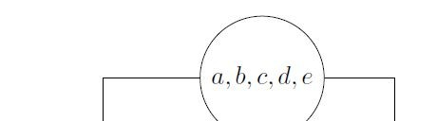
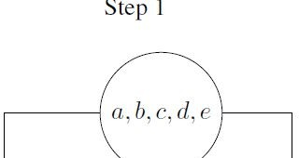
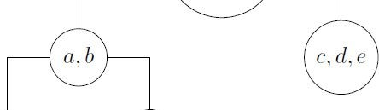
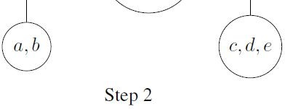

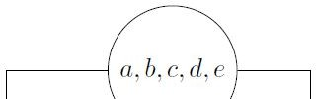


Slide 31
DENSITY BASED CLUSTERING
Clustering based on density (local cluster criterion), such as density-connected points
Major features:
Discover clusters of arbitrary shape
Handle noise
Need density parameters as termination condition

Slide 32
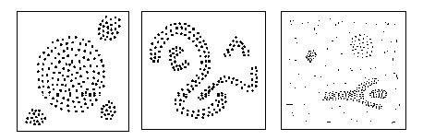
Density
54
Based Clustering
In density-based clustering, each cluster has a considerable
higher density of points than outside of the cluster
Objects in the sparse areas (that are required to separate clusters) are usually considered to be noise and border points
Density-Based Spatial Clustering of Applications with Noise
(DBSCAN) is most widely used density based algorithm

Slide 33



Terminology and notations
55
Let Є(epsilon) be some constant distance. Let p be an arbitrary data point. The neighbourhood of p is the set
We choose some number m0 to define points of “high density”: We say that a point p is point of high density if contains at least m0 points.
We define a point p as a core point if has more than m0 points.
We define a point p as a border point if has fewer than m0 points, but is in the Є neighbourhood of a core point.
A point which is neither a core point nor a border point is called a noise point.

Slide 34
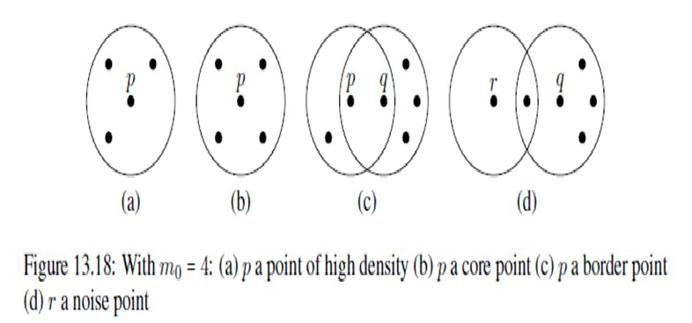

Slide 35


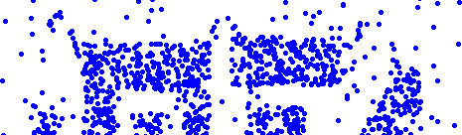
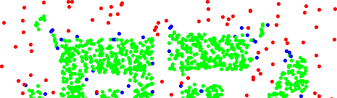
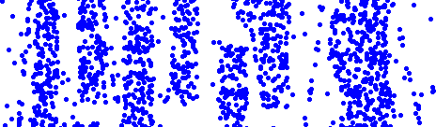
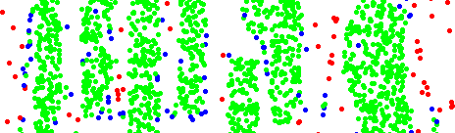


DBSCAN: Core, Border and Noise Points
57
Original Points
Point types: core, border and noise
Eps = 10, MinPts = 4

Slide 36



Slide 37


Slide 38
Advantages
Does not require a-priori specification of number of clusters.
Able to identify noise data while clustering.
DBSCAN algorithm is able to find arbitrarily size and arbitrarily shaped clusters.
Disadvantages
DBSCAN algorithm fails in case of varying density clusters.
Does not work well in case of high dimensional data.
Still requires user to supply Minpts and ε

